Slide 1
Android Development
Android Studio, Activities & Fragments

Slide 2
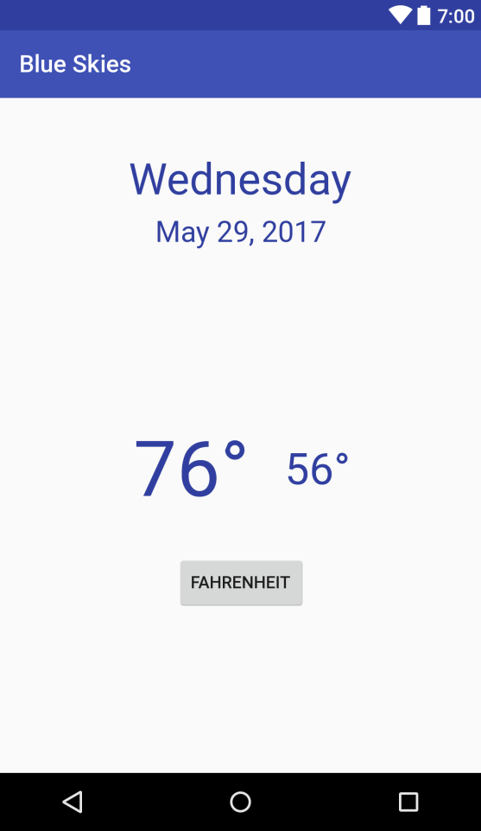
Goals
Develop a Blue Skies App
Activity
Fragment
Layout
Services
Http communication

Slide 3
What is Android
Google mobile SDK
Written in Java

Slide 4
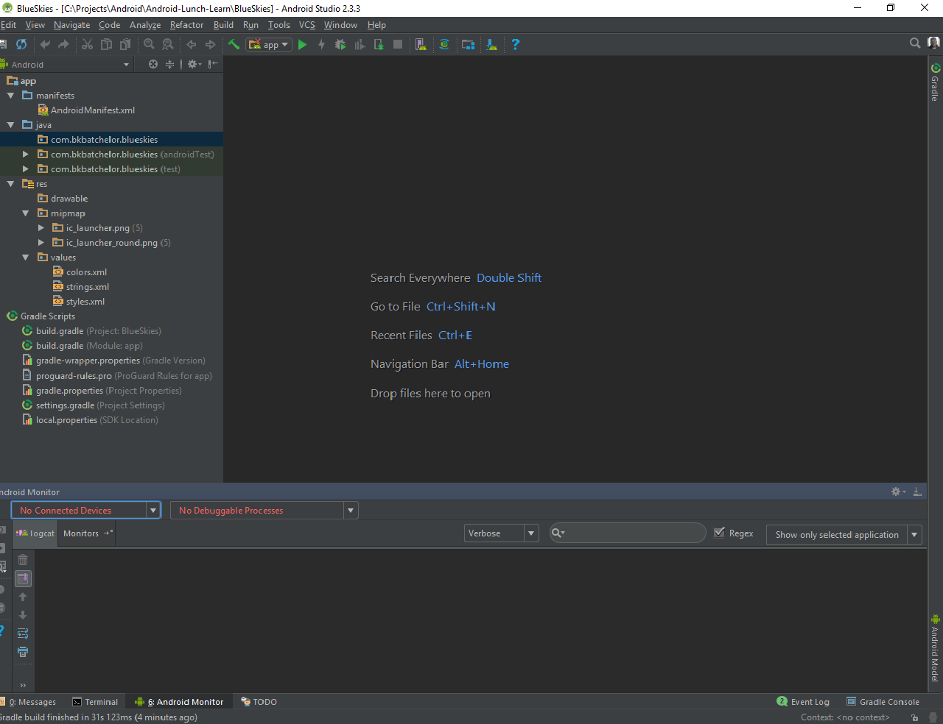
Android Studio
De facto standard for Android development
Built on the IntelliJ
Some features
Layout Editor
Built in emulator
Gradle integration
Instant Run (Hot swap)
https://developer.android.com/studio/index.html

Slide 5
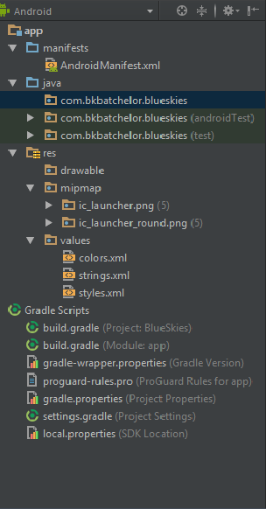

Project Pane

Slide 6
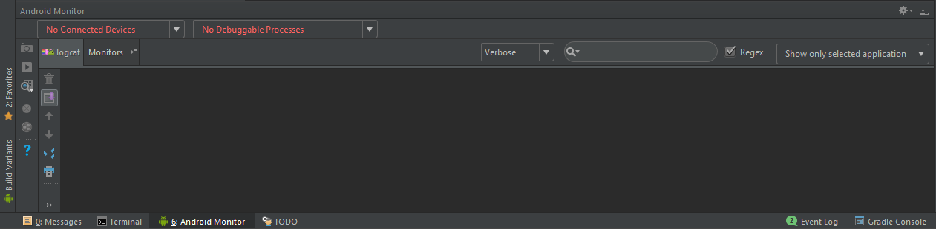
Monitoring and Logcat pane

Slide 7

Run and Debug

Slide 8
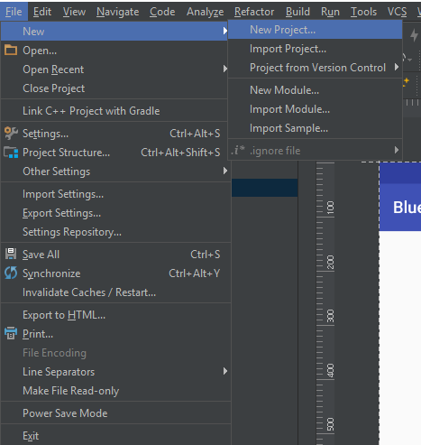
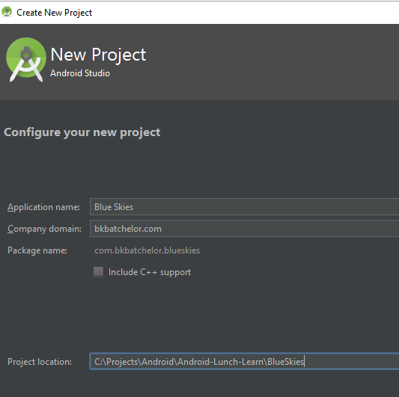
New Project

Slide 9
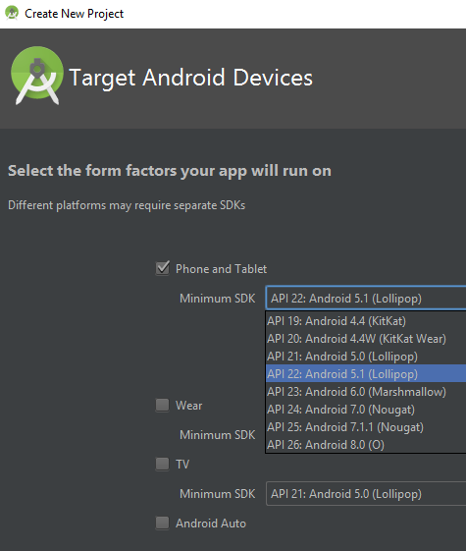
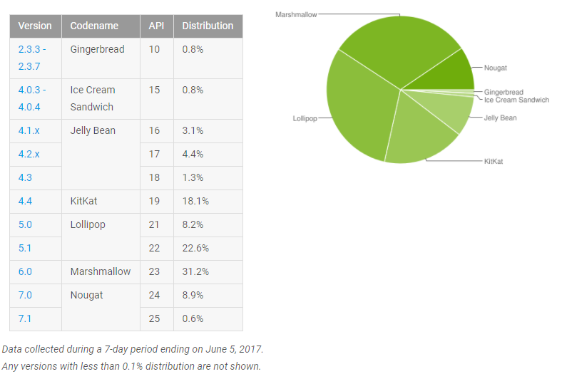
New Project (cont)

Slide 10
Live Example: Android Developer References

Slide 11
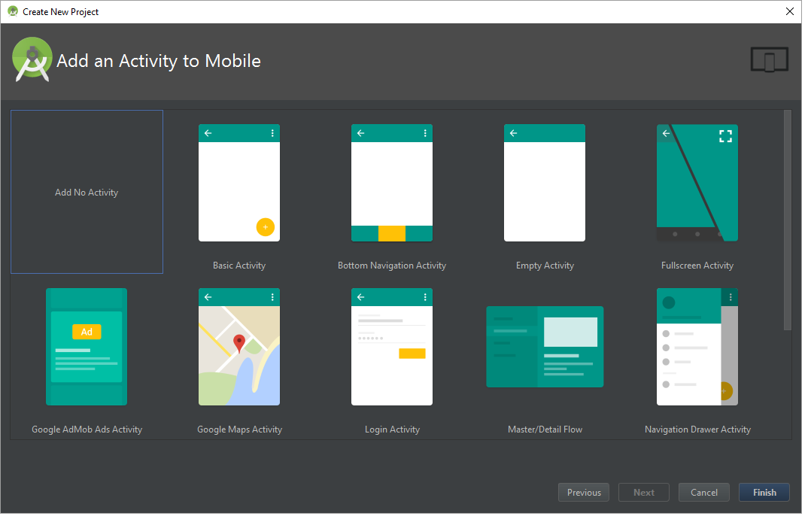
Add Activity

Slide 12
Exploring build.gradle file
Set target SDK version
Set minimum SDK version
Define dependencies

Slide 13
Activity

Slide 14

Activity https://developer.android.com/guide/components/activities/index.html
Fundamental building blocks
Entry point for user's interaction
Provides navigates within an app
Communication between other activities
Communication between child fragments
No Creation or Modification of Views

Slide 15
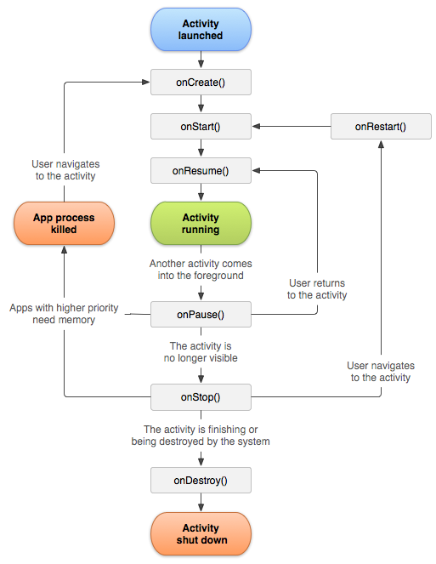
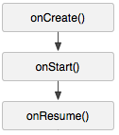
Activity Lifecycle
onCreate() started, but not visible
onStart() visible, but not ready for interaction
onResume() moved to the foreground and ready for interaction

Slide 16
onStart()

Slide 17
Activity Lifecycle
onCreate() started, but not visible
onStart() visible, but not ready for interaction
onResume() moved to the foreground and ready for interaction

Slide 18
onStart()

Slide 19
Activity Lifecycle
onCreate() started, but not visible
onStart() visible, but not ready for interaction
onResume() moved to the foreground and ready for interaction

Slide 20
onResume()

Slide 21

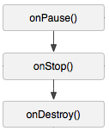
Activity Lifecycle
onPause() moving to the background and stopping user interaction
onStop() moved to the background and not visible
onDestroy() moved to the background and flagged to be destroyed by the system

Slide 22
Cycle Relationships

Slide 23
Creating MainActivity
Best Practices
Keep lifecycle methods in order
Place other methods (helpers) below the lifecycle methods

Slide 24
XML Layout
Add XML Layout
XML Layout holds ViewGroups (layouts) and View (widgets)
Best practices
Layout naming convention
MainActivity.java => main_activity.xml

Slide 25
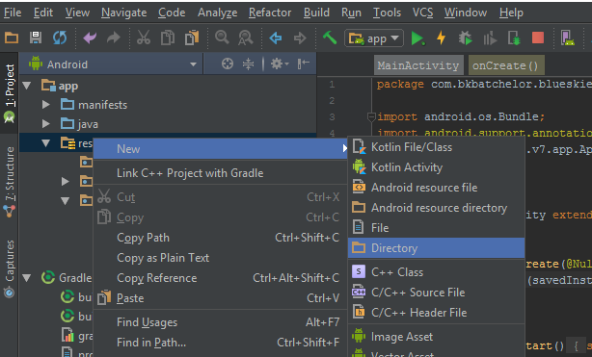
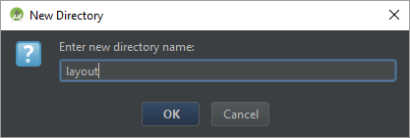
Creating Layout directory

Slide 26
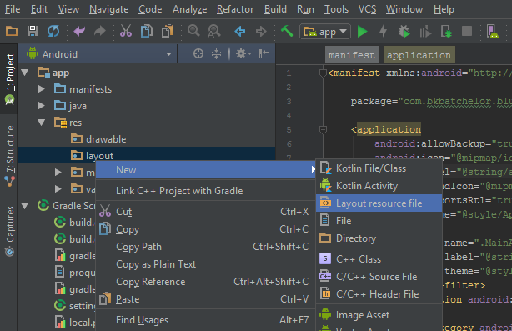
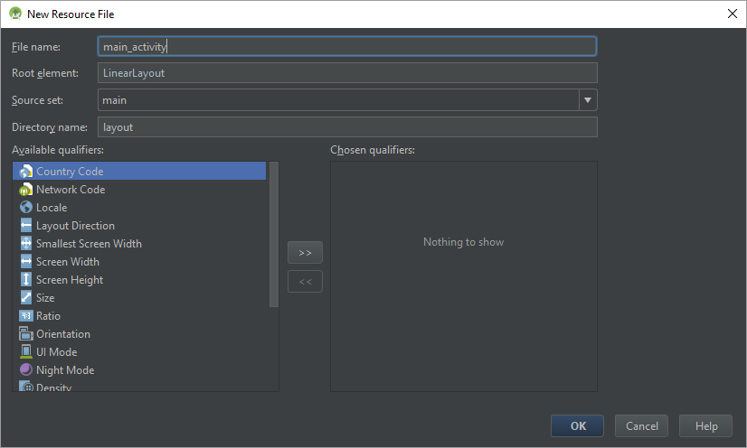
Creating layout XML

Slide 27
Show main_layout.xml

Slide 28
Layouts
Types of layouts
Linear
Relative
Frame
Constraint
Best Practices
Attempt to keep the layout flat by avoiding nest layouts

Slide 29
Live Example: Link Activity to Layout

Slide 30
Editing Android Manifest
Add MainActivity to AndroidManifest.xml
The manifest file provides essential information about your app to the Android system, which the system must have before it can run any of the app's code. (i.e. activities, services, content provider…)

Slide 31
Live Example: Adding MainActivity to manifest file

Slide 32

Fragments

Slide 33
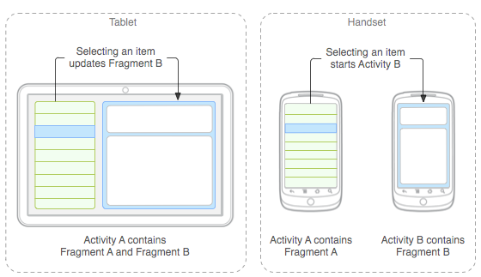

Why Fragments?
Reusing View and Logic
Single responsibility
Phone and tablet layouts
Screen orientation

Slide 34
Fragment Responsibilities
View and Layout logic
Event handling (i.e. onClick())
Network request
Interacting with a persistence storage

Slide 35
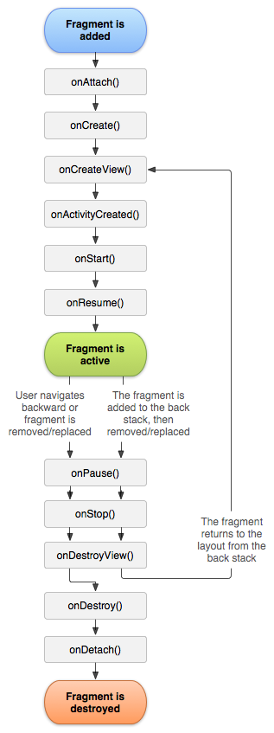
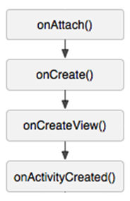
Fragment Lifecycle
onAttach() connected to an activity, but not started
onCreate() started, but view object has not been created
onCreateView() started, view object being created, but not visible
onActivityCreated() started, view object instantiated by parent Activity, but not visible

Slide 36
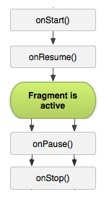
Fragment Lifecycle
onStart() visible, but not ready for interaction
onResume() moved to the foreground and ready for interaction
onPause() moving to the background and stopping user interaction
onStop() moved to the background and not visible

Slide 37
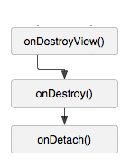
Fragment Lifecycle
onDestroyView() not visible and view detached from fragment
onDestroy() flagged for deletion
onDetach() detached from parent Activity

Slide 38
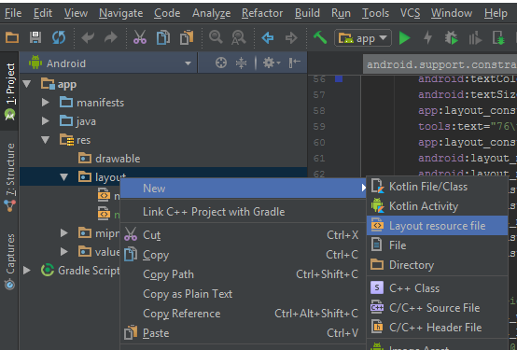

Creating Fragment XML Layout

Slide 39
Show Fragment Layout Code

Slide 40
Density Independent Pixel (dp)
View Groups and View dimensions
Scale according to screen density, not screen size

Slide 41
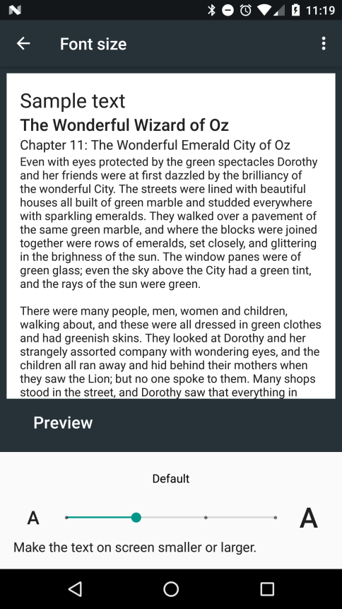
Scale Independent Pixel (sp)
Controlling text size
Scale according to screen density, not screen size
Also, scales according settings font settings

Slide 42
Fragment Code
Logic to fragment XML layout
onClick()

Slide 43
Show Fragment Code

Slide 44
Live Example Fragment Code

Slide 45
Adding Fragment to Activity

Slide 46
Extra

Slide 47
Landscape Layout

Slide 48
Fragment callbacks

Slide 49
Dynamic Fragments

Slide 50
Passing arguments to Fragments

